Slide 1

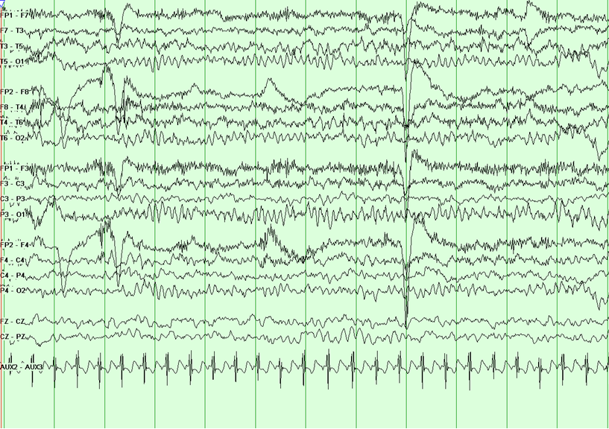
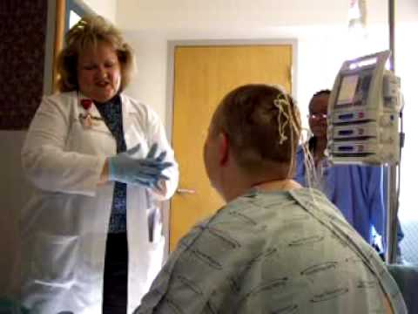
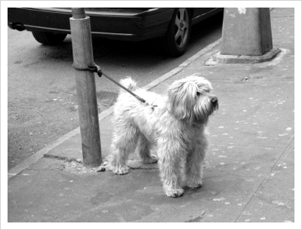
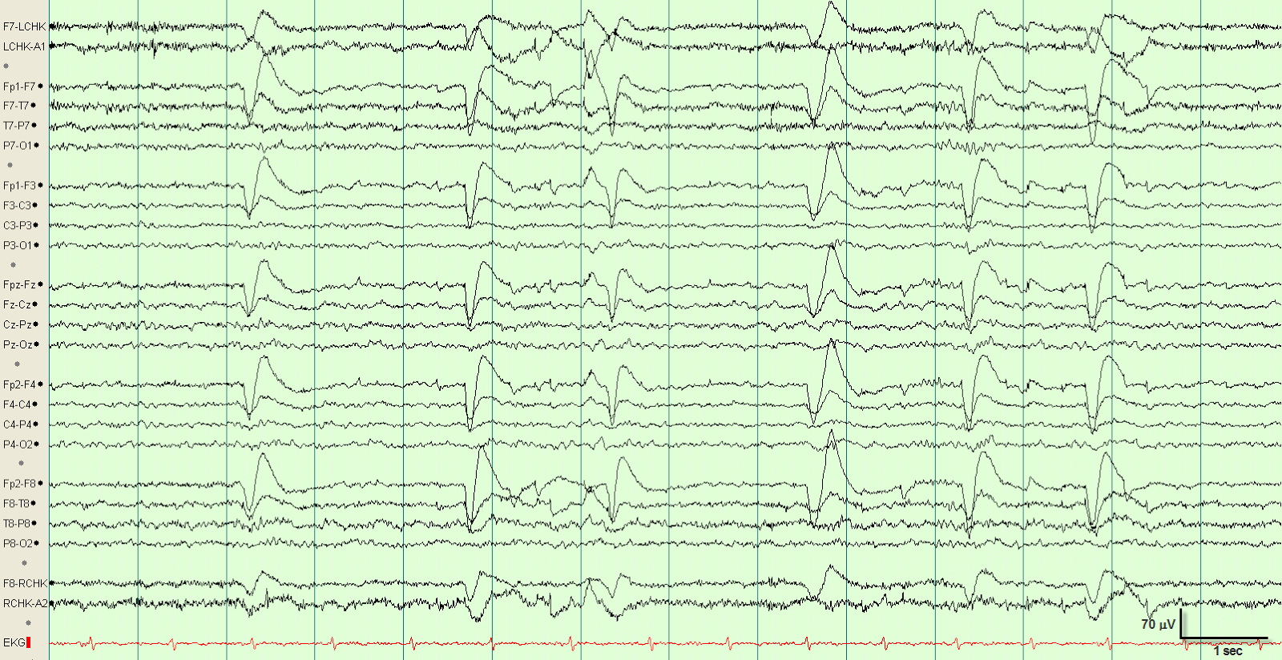
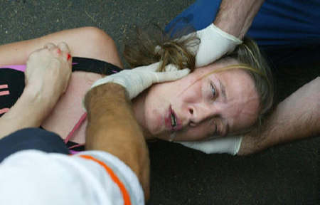

Slide 2
WIRELESS NEURAL RECORDER
Untethering 70 Million Epilepsy Patients

Slide 3
Affected Patients
1% of Population suffers from Epilepsy | 10 - 25 Million Operations/ Year
5 - 6 Days per Operation

Slide 4
Customers – EEG Service Providers
Hospitals | Clinics | Research Institutes
4000 | 5000 | 150

Slide 5
Total Market Value
Customers * Machines * Unit Price
$ 300 Million

Slide 6
Customer Requirements
Safety (FDA, HIPAA, WHO MDR)
Convenience & Mobility
Accuracy & Reliability
Application development platform

Slide 7
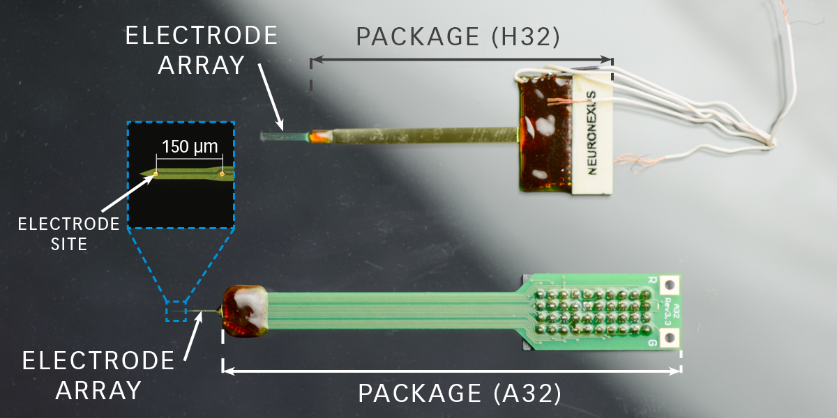
Existing Product (NEuronexus)
Wired Connection
Large form factor

Slide 8
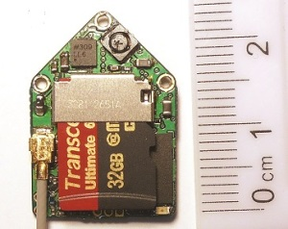
DEUTERON Wireless Neural Logger
Animal only application
Too Large
Not real-time

Slide 9
Design Specifications
Customer Needs
Safe for Humans
Real-Time Data Transfer
Design
Skin Temperature Change: < 2° C
Feedback Current: 0 mA
Accurate & Comprehensive
Low Power & Long Lasting
Portable & Convenient
Transmission Rate: 128 kB/s
Sampling Rate: 1 kHz
Sampling Precision: 16-channel, 8-bit samples
Battery Life: at least 24 hours
Module Size: 4x4 mm

Slide 10
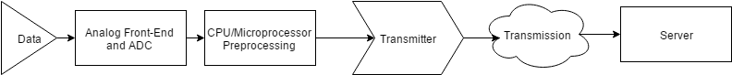
System Diagram

Slide 11

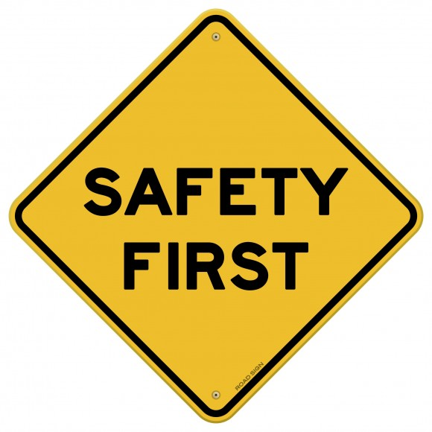
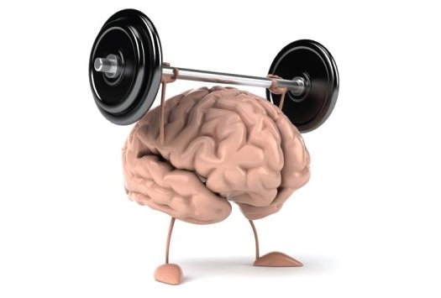
Challenges

Slide 12
Wireless Options
Wifi
High Range
Bluetooth
Low Energy
High Range
Medium Bandwidth
Near Field
Communication
Low Range
RF4CE
ZigBee
High Bandwidth
High Data Transfer
Medium Power Consumption
Medium Data Transfer
Low Power Consumption
Low Bandwidth
Low Data Transfer
Low Power Consumption
Medium Range
Low Bandwidth
Medium Data Transfer
Low Power Consumption
High Range
Medium Bandwith
High Data Transfer
High Power Consumption
5 Potential Options for Wireless Data Transfer

Slide 13
Wireless Options
Wifi
High Range
Bluetooth
Low Energy
High Range
Medium Bandwidth
Near Field
Communication
Low Range
RF4CE
ZigBee
High Bandwidth
High Data Transfer
Medium Power Consumption
Medium Data Transfer
Low Power Consumption
Low Bandwidth
Low Data Transfer
Low Power Consumption
Medium Range
Low Bandwidth
Medium Data Transfer
Low Power Consumption
High Range
Medium Bandwith
High Data Transfer
High Power Consumption
5 Potential Options for Wireless Data Transfer

Slide 14
Bluetooth Low Energy
Will use TI CC2640 BLE 4.2 as our data transmission source with optimal tradeoff between performance and power
Industry-leading privacy. Keeps Bluetooth Smart devices from being tracked.
Highly secure. Features industry-standard encryption ensuring confidential data stays that way.
More power efficient. Introduces refinements that make Bluetooth Smart even more power-stingy.

Slide 15
Power Options
Powering the electrode is a huge challenge due to size and longevity constraints
2 Options
High density replaceable medical device batteries
Inductive charging via brain’s electrical impulses

Slide 16
Power Options
Powering the electrode is a huge challenge due to size and longevity constraints
2 Options
High density replaceable medical device batteries
Inductive charging via brain’s electrical impulses

Slide 17
3 Stage Testing
Stage 1
Single electrode circuit prototype
Test BLE technology with generated signals
Debug circuit and improve design
Stage 2
Multiple electrodes prototype
Test multi-system communications
Test battery performance in simulated brain condition
Stage 3
Full 16 electrode system
Mobile data recording device
Animal testing in real world environment

Slide 18
Wireless Neural Recorder
Applications not only limited to epilepsy
Sleep diagnosis
Diagnosis diseases of the brain
Coma analysis
Brain stimulation
Improve Epilepsy patients’ quality of life
Untether them from the limitation of existing technology
Improve monitoring with more data for better procedural

Slide 19
